Slide 1
Seminar: Analizzare Dati di Vapori per la Detection di New Psychoactive Drugs
The EU PENTION Project

Slide 2
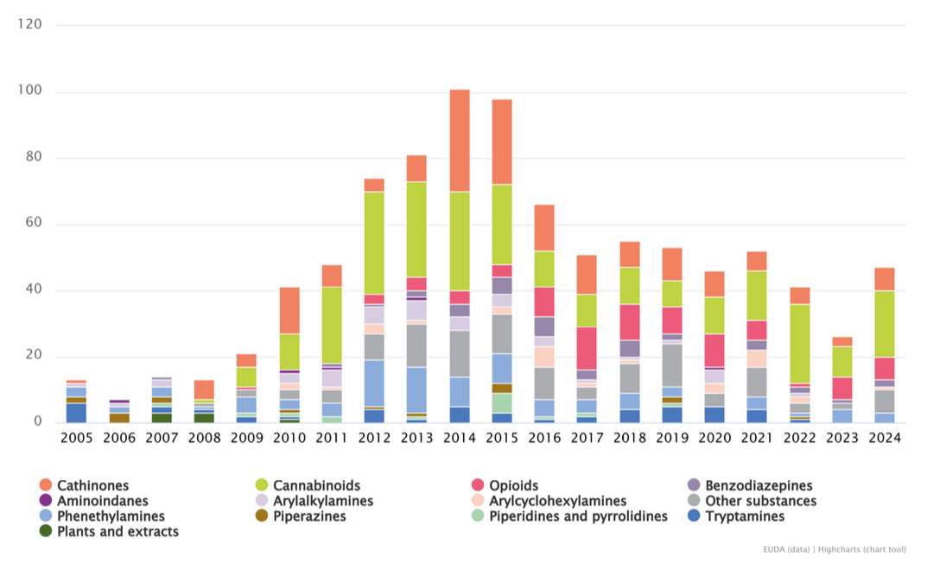
The problem: Psychoactive Drugs

Slide 3
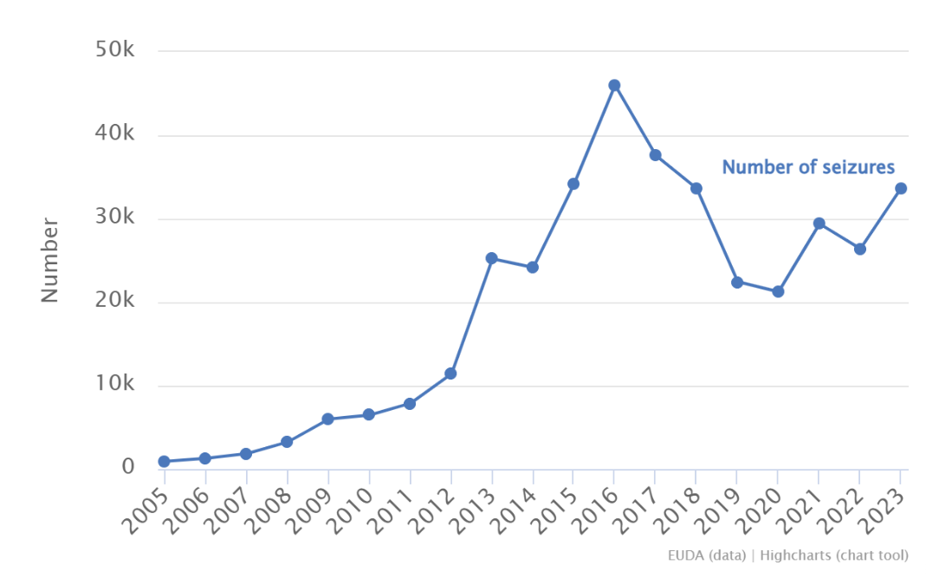
Main Stakeholder: LEAs

Slide 4
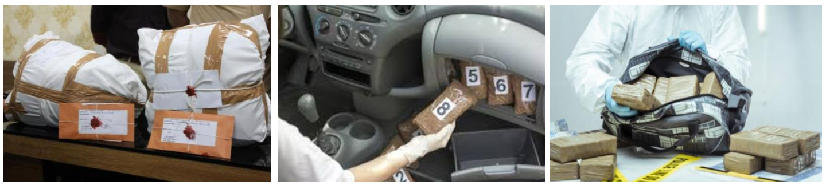

Slide 5
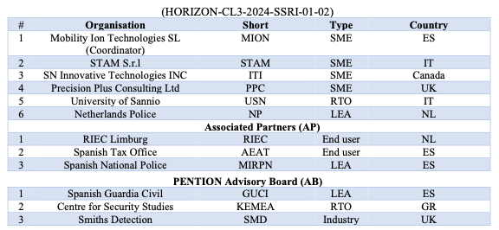

Slide 6
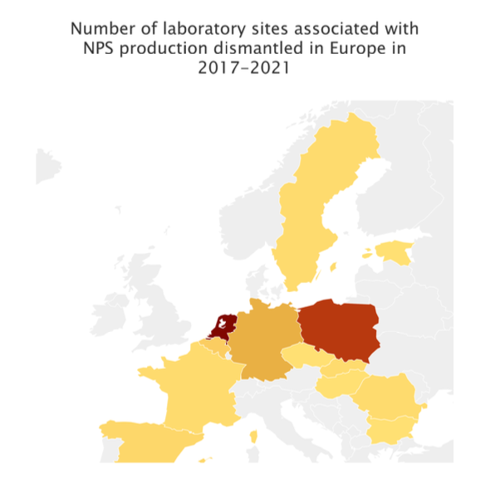
Stakeholders Involved
Dutch Police
Spanish Guardia Civil
ENLETS

Slide 7
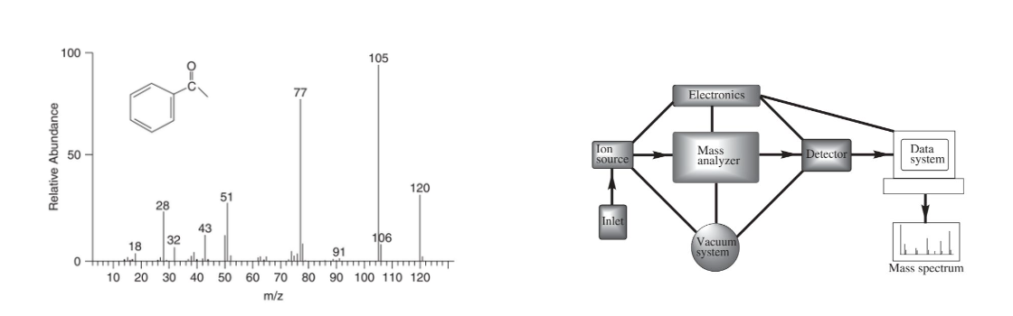
How do we do it manually?

Slide 8
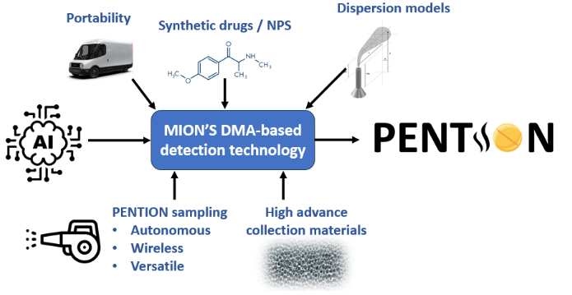

Slide 10
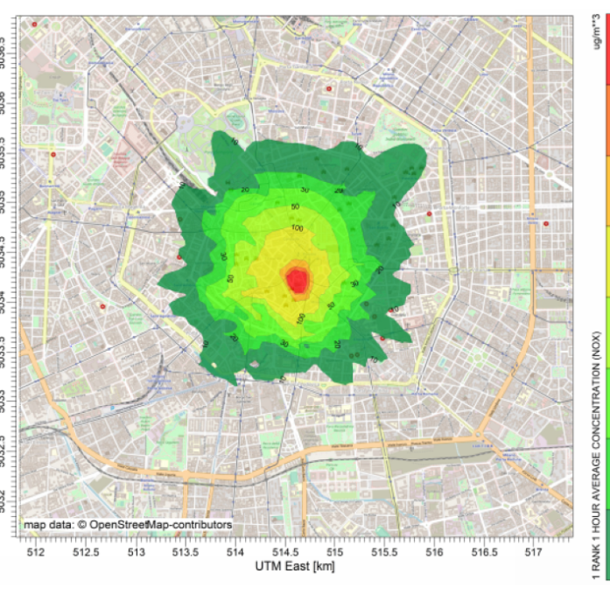
A better way, the big data way

Slide 11
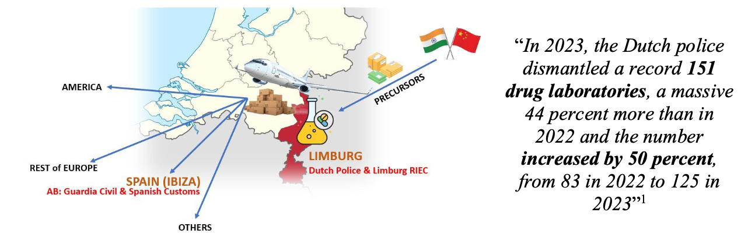
CRISP-DM: Data Problem

Slide 12
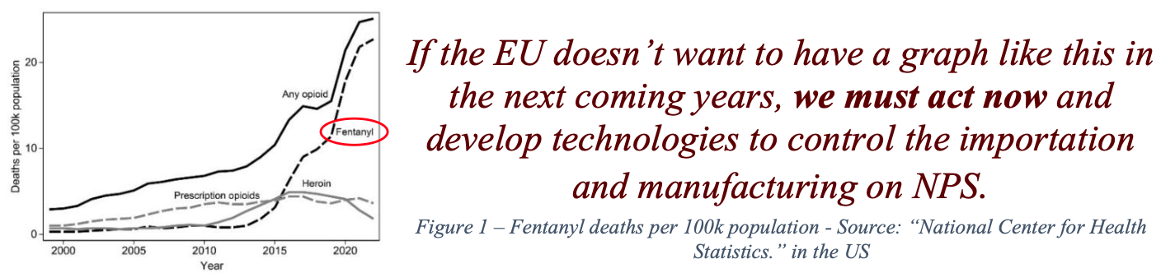
CRISP-DM: Data Problem (cont’d)

Slide 13
CRISP-DM: Data Involved
Dispersion in the wind (mass, concentration, etc.)
Wind speed, direction, density
substances and interferants
Pollution density
Terrain morphology
…

Slide 14
CRISP-DM: Data Objectives
Obtain dispersion model with center on potential lab
Allow LEAs easier planning of sweeps and detection of labs
Provide forensic-ready evidence
Provide a secure layer

Slide 15
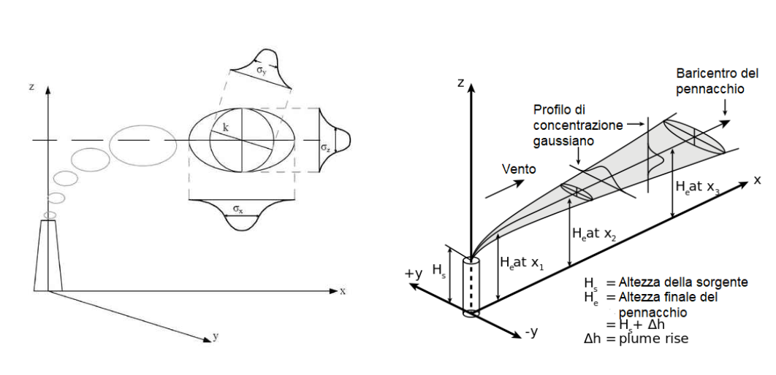
The Big Data Model: Gaussian Puff

Slide 16
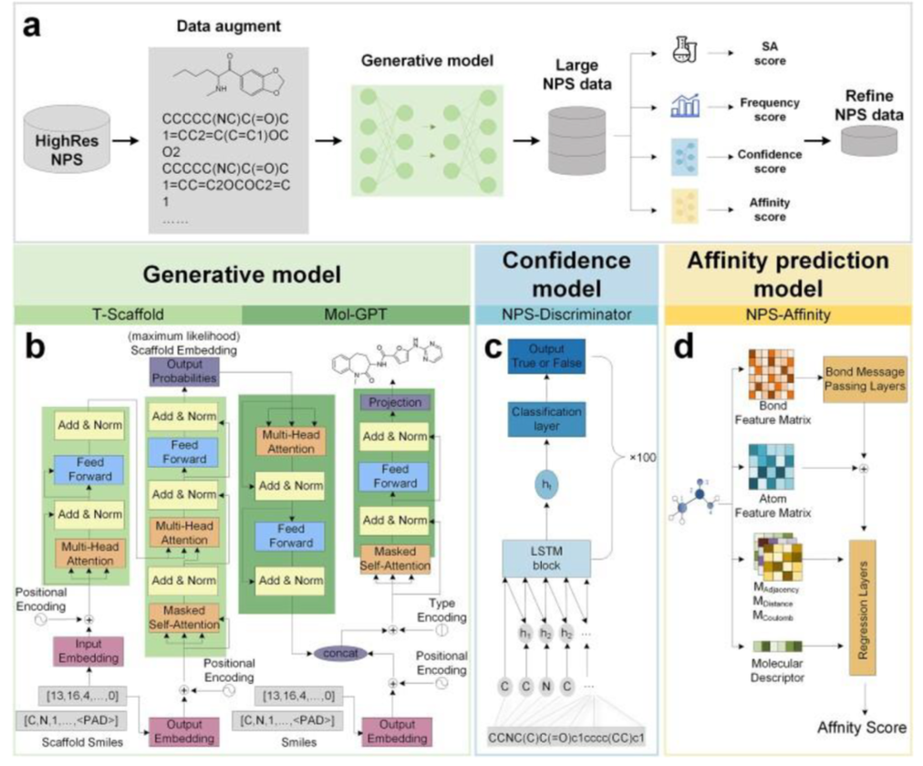

Slide 17
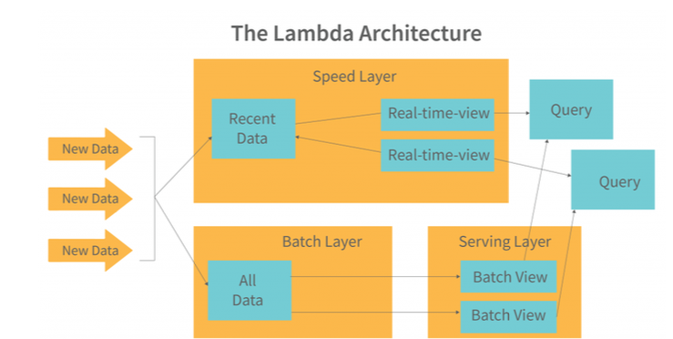

Slide 18
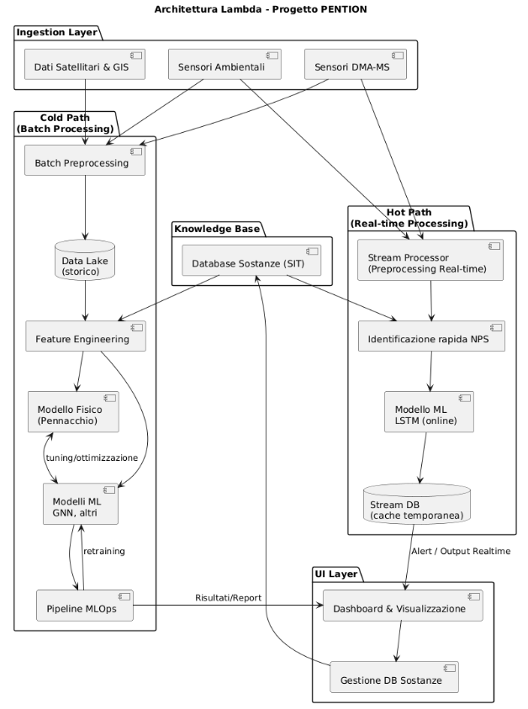
Big data ingestion
Rapid (stream) processing
Cold processing
Presentation & business intelligence

Slide 19
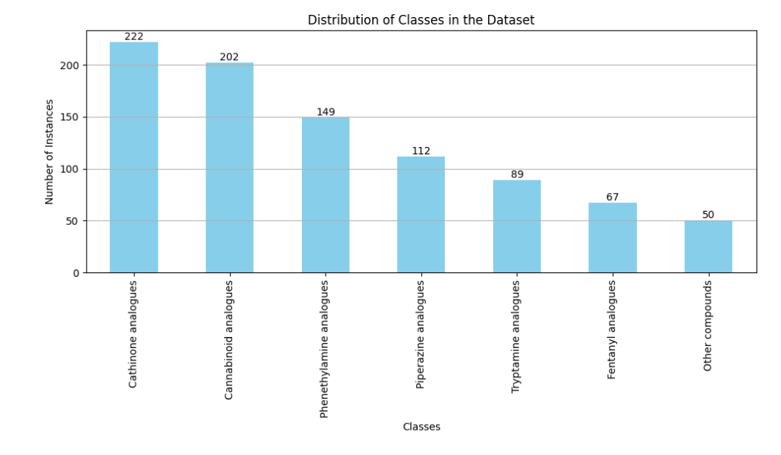
Testing the Framework
Open-source datasets
Open-source databases

Slide 20
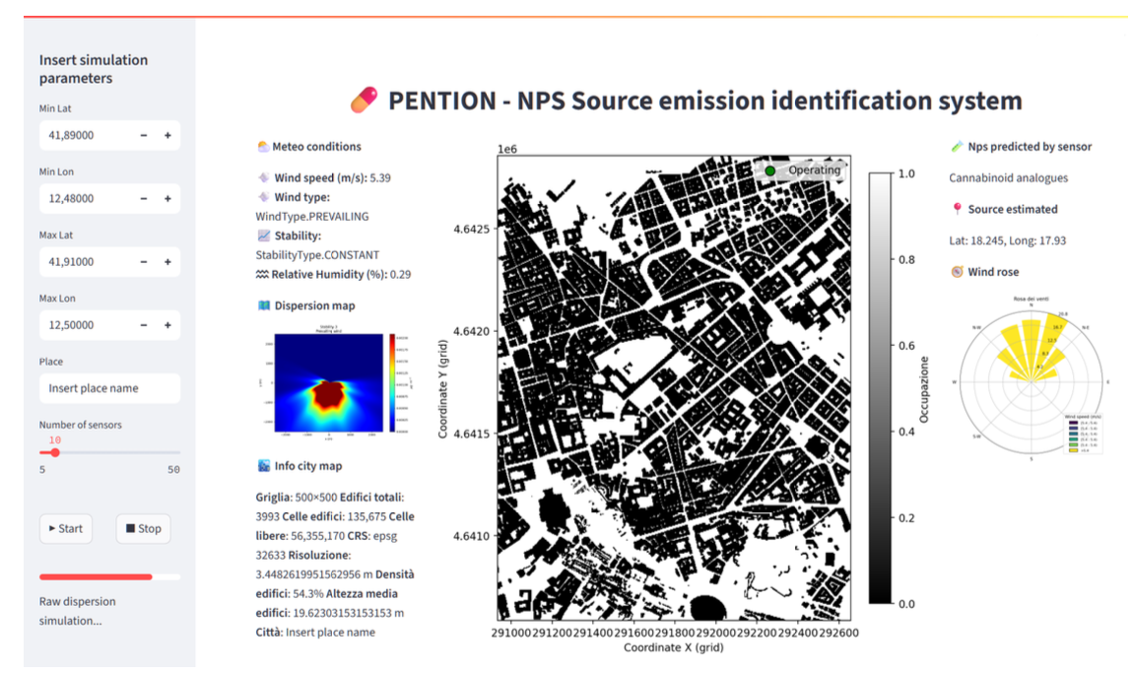

Slide 21
<Demo>

